Slide 1

15 can’t miss commands in dbatools 1.0
Chrissy LeMaire Jess Pomfret
Cláudio Silva Spaghetti DBA
Rob Sewell Andre Kamman
Notes:
This is the slide shown before the presentation starts. When you are ready to go, tell the video operator to start the recording, and click to the next slide.

Slide 2











Slide 3

This Session
Will highlight some PowerShell commands that will simplify your life
and practically do your dishes
Notes:
me

Slide 4

Agenda
Overview of the journey to dbatools 1.0
Demos galore
Notes:
me

Slide 5
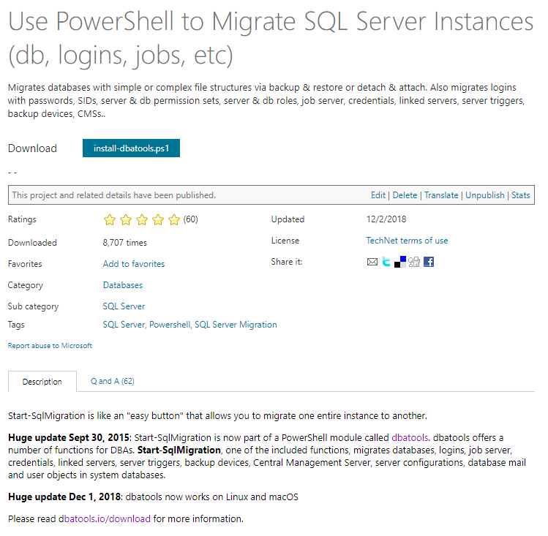
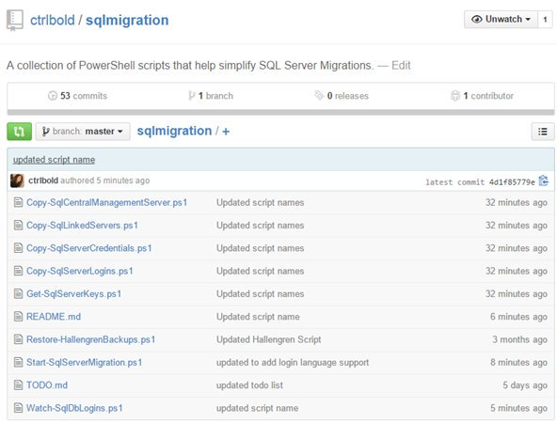
The beginning - July 2014
Start-SqlMigration.ps1 in Script Center
sqlmigration folder on GitHub
Notes:
me

Slide 6

The module - September 2015
dbatools module in GitHub
Notes:
me

Slide 7
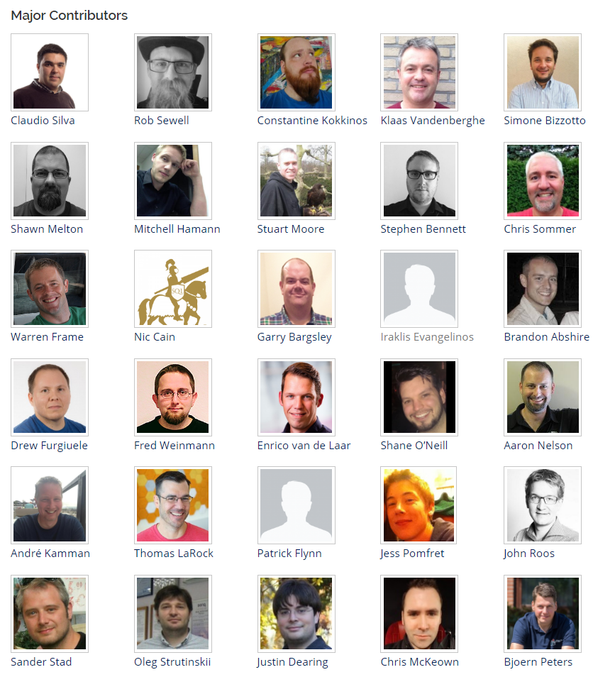
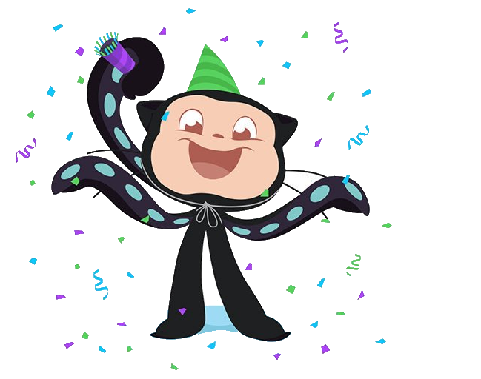

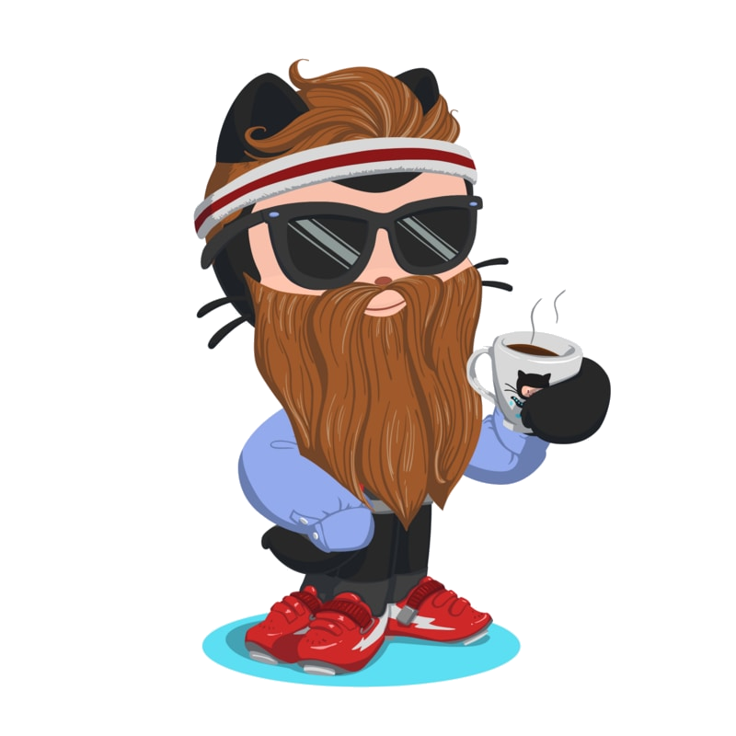
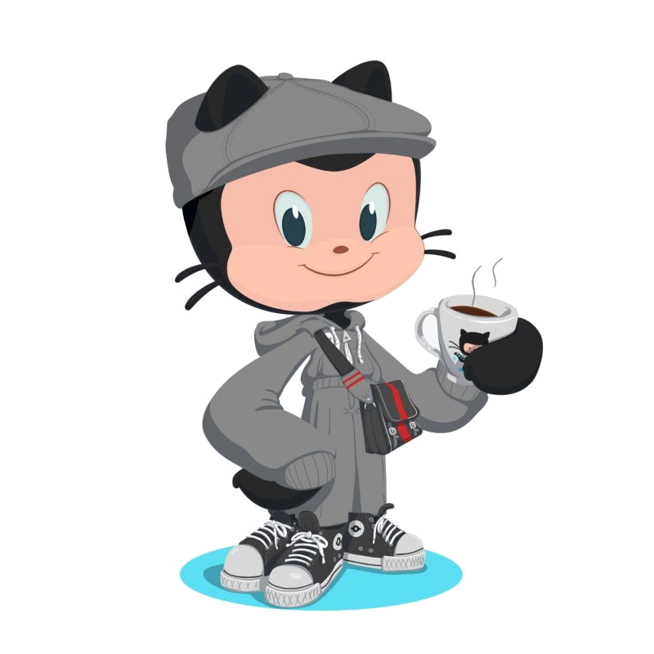
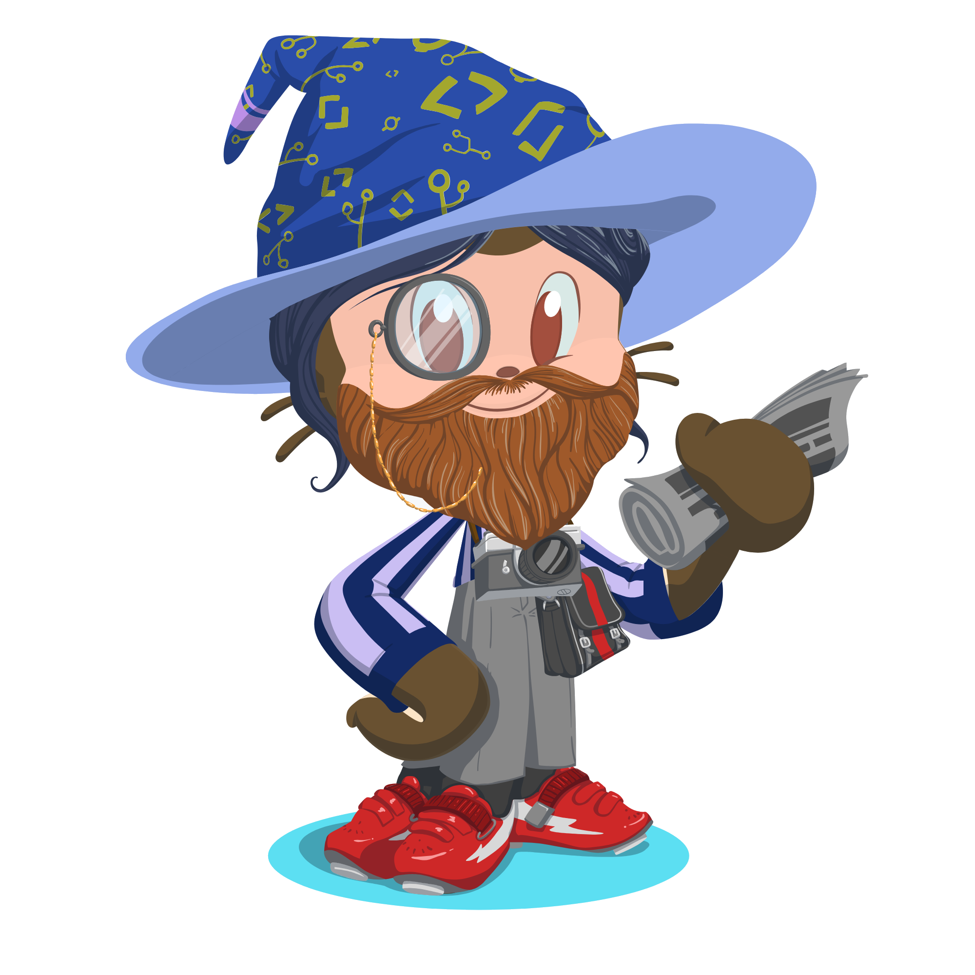
The community - June 2016
Others started joining in!
Notes:
c;laudio

Slide 8

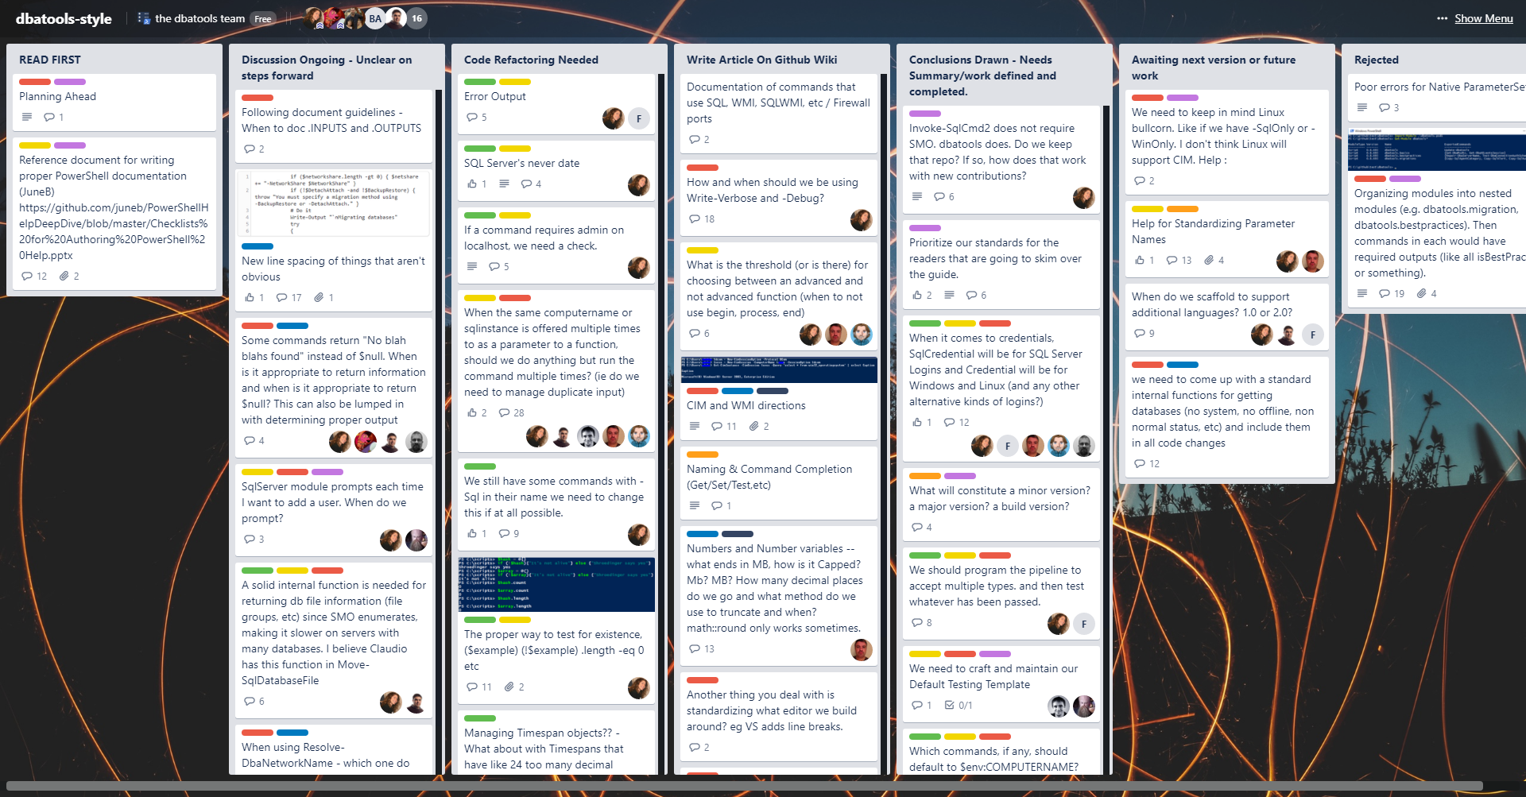
1.0 Officially Begins – January 2017
Notes:
claudio

Slide 9
1.0 Officially Begins – January 2017
Standardized documentation
Standardized names for parameters, commands, etc
Standardized outputs
Added Pester tests and AppVeyor
Testing
Bug fixes
Releasing more often
Notes:
clauidio

Slide 10

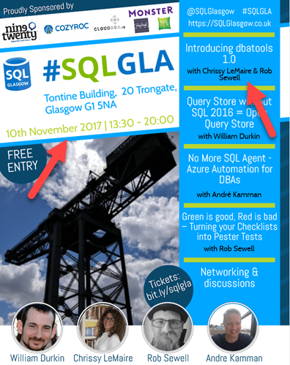
Oops - November 2017
Notes:
rob

Slide 11

Now
dbatools is officially out now!!!!
Over 160 contributors!
MIT!
Supports Azure a bit better!
Runs on PowerShell Core!
75% of commands run on Mac/Linux!
Still supports PowerShell 3, too!
Still supports SQL Server 2000, mostly!
Will have an accompanying MEAP!
Notes:
Rob

Slide 12
Demo grouping
Classics
Fan Favorites
Must Haves
Combo Kills
Notes:
rob

Slide 13
PARTY TIME

Slide 14
Notes:
[REQUIRED SLIDE]
If you sticked to your timing, you now have 15 min left for Q&A. If you missed your timing, you will have to leave the room when your slot is over. In this case, invite your audience to the coffee break and offer to cover questions there.
IN ANY CASE please point your audience to the conference app and the session voting. By the time the conference opens, the eventraft app *should* have the option to vote on sessions.
Please MAKE SURE you leave your room when your slot is over. The next speaker would like to set him/herself up and get everything up and running.

Slide 15
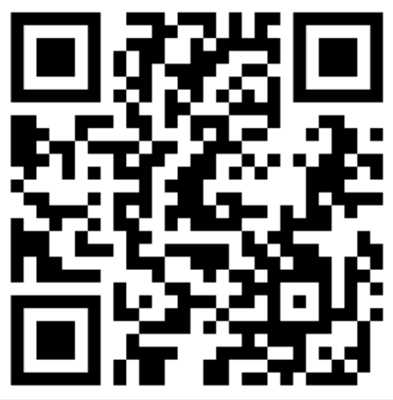
Session Feedback Day 1 (not optional!)
http://bit.ly/DataGrillen2019Day1

Slide 16
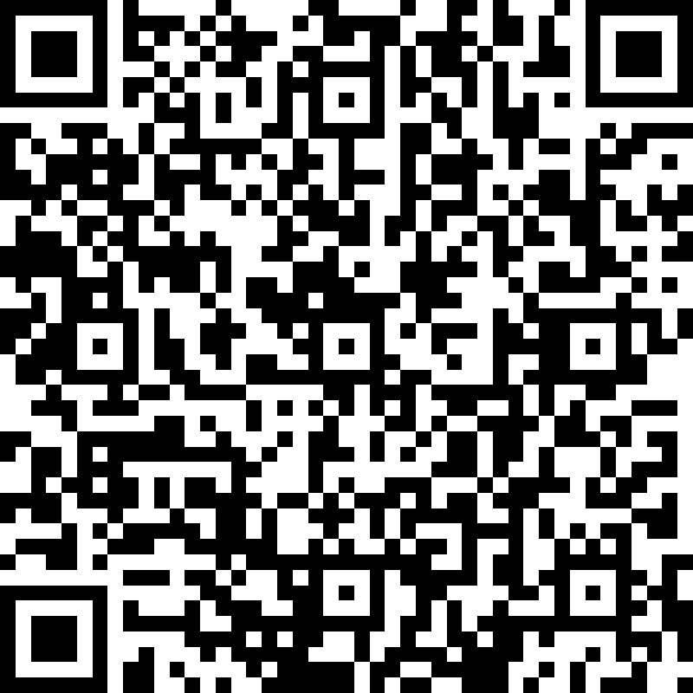
Event Feedback (not optional!)
http://bit.ly/DataGrillen2019Event

